Slide 1

Ch. 7: Tracking The Economy
How to track the performance of the economy
GDP and Inequality, Gini Coefficient
GDP and the three ways of calculating it
The real GDP and nominal GDP
GDP Deflator, another price index
CPI, Consumer Price Index
To First
Active Learning
To Video

Slide 2
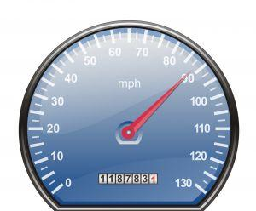
National Income Accounting
The national income and product accounts (NIPA)
- Simon Kuznets (1930s)
- Gross Domestic Product (GDP)
measure a nation’s economic performance
compare income - output to that of other nations
track the economy’s condition throughout the business cycle
BEA.gov

Slide 3
GDP & Inequality
+ GDP measures the “overall” performance of an economy
+ GDP gives a quick assessment when slowdown (recession) or heating up (expansion)
GDP does not show the Inequality and poverty
- Gini coefficient: a measure of %wealth v. % population; index between 0 – 1 (or 100%); 1 being max inequality. Current range: 0.24 – 0. 64; US is 0.44, Sweden 0.24
poverty: 15% US population, social mobility, inter-generational persistence of poverty
Informal economy (underground economy/black market): farming, barter
Population structures: young-old workers, male-female workers, sparsely-populated v. dense-populated)

Slide 4
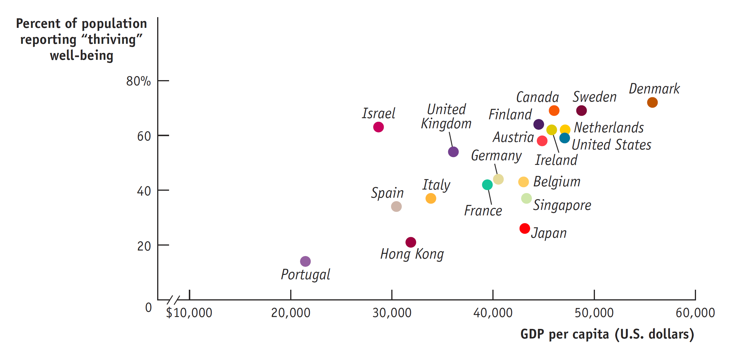
GDP and the Meaning of Life
Rich is better. But….
Money matters less as you grow richer.
Money is not everything.
Source: Gallup; World Bank.

Slide 5




Circular-Flow: 4 Players, 3 Markets
Government purchases of goods and services
Government borrowing
Consumer spending
Taxes
Government transfers
Private savings
Wages, profit,
interest, rent
Markets for goods and services
Factor markets
Financial markets
Wages, profit, interest, rent
GDP
Borrowing and stock issues by firms
Investment spending
Foreign borrowing and sales of stock
Exports
Imports
Foreign lending and purchases of stock

Slide 6
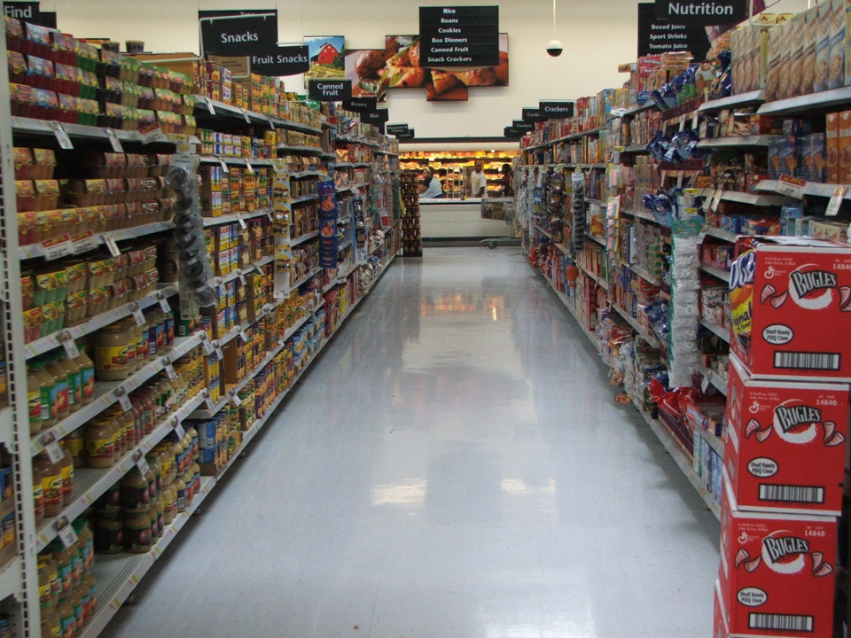
What Is GDP?
Gross domestic product (GDP):
the market value
of all final
goods and
services produced within a country in a year.

Slide 7

GDP, The National Accounts
Final goods and services: goods and services sold to the final, or end, user.
Intermediate goods and services: goods and services (bought from one firm by another firm) that are inputs for production of final goods and services.
Annual: all produced in that year.
(used good –not)
(quarterly GDP report, but year-over-year)
The sale of financial assets, such as stocks and bonds, are not included.

Slide 8

What is GDP?
…Within a Country…
Only production that takes place within the borders of a country is included in GDP.
Examples:
Cars produced in Mexico by American firms: NOT included in the U.S. GDP.
Cars produced in the U.S. by Japanese firms ARE included in the U.S. GDP.
What is GNP?
U.S. GNP > GDP by 0.7%
Ireland’s GNP < GDP by 15%

Slide 9
Are the following included in U.S. GDP?
The price paid by a German tourist when staying at a New York hotel.
(2) The price paid by an American tourist when staying at a Berlin hotel.
Both are included in U.S. GDP.
Neither is included in U.S. GDP.
Only the price paid by a German tourist when staying at a New York hotel is included in U.S. GDP.
Only the price paid by an American tourist when staying at a Berlin hotel is included U.S. GDP.
To Next
Active Learning

Slide 10
GDP: WHAT’S IN AND WHAT’S OUT
Included
Domestically produced final goods and services, including capital goods, new construction of structures, and changes to inventories
Not Included
Intermediate goods and services
Inputs to production
Used goods
Financial assets, such as stocks and bonds
Goods and services produced outside this country

Slide 11
Check this out
What’s in and what’s out?
Hamburger buns bought by McDonald’s Corp.
A used macroeconomics textbook
A new Chrysler car
A newly purchased stock
An antique clock of 18th century
Steel purchased by GM to make new Chevy volt

Slide 12
Calculating Gross Domestic Product
GDP can be calculated three ways:
Add up the value added of all producers.
Add up all spending on domestically produced final goods and services. This results in the equation GDP = C + I + G + (X – IM)
where C = consumer spending, I = investment spending, G = government purchases of goods and services, X = sales to foreigners, and IM = imports (purchases here of foreign goods… or income that has leaked across national borders).
Add up all income paid to factors of production.

Slide 13

(Aggregate) Spending = (Agg) Income
It doesn’t matter HOW we measure the production, since one person’s spending is another’s income.
$10 for a shave? Barber’s income of $10 = customer’s spending of $10.

Slide 14
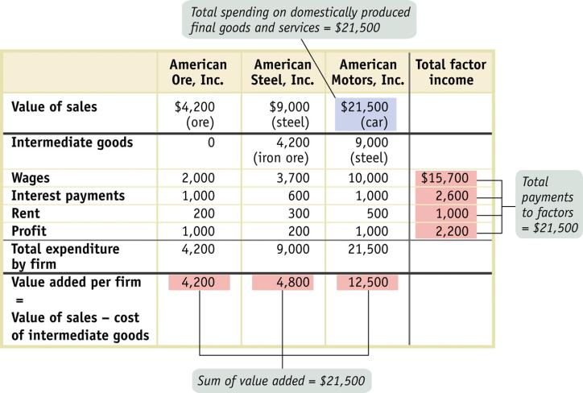
Calculating Gross Domestic Product
Notes:
.

Slide 15
Value Added vs. Spending Method
Components of GDP (billions of dollars)
$15,000
10,000
5,000
0
-5,000
Value added by government
= 12.5%
Government purchases of goods and services
= 20.7%
Value added by households
= 12.7%
Investment spending
= 12.4%
C + I + G
= $15,044
Value added by business
= 74.9%
Consumer spending
= 70.5%
Value added by sector
Net exports X – IM = (–3.6%)
Net exports: the difference between the value of exports and the value of imports.

Slide 16
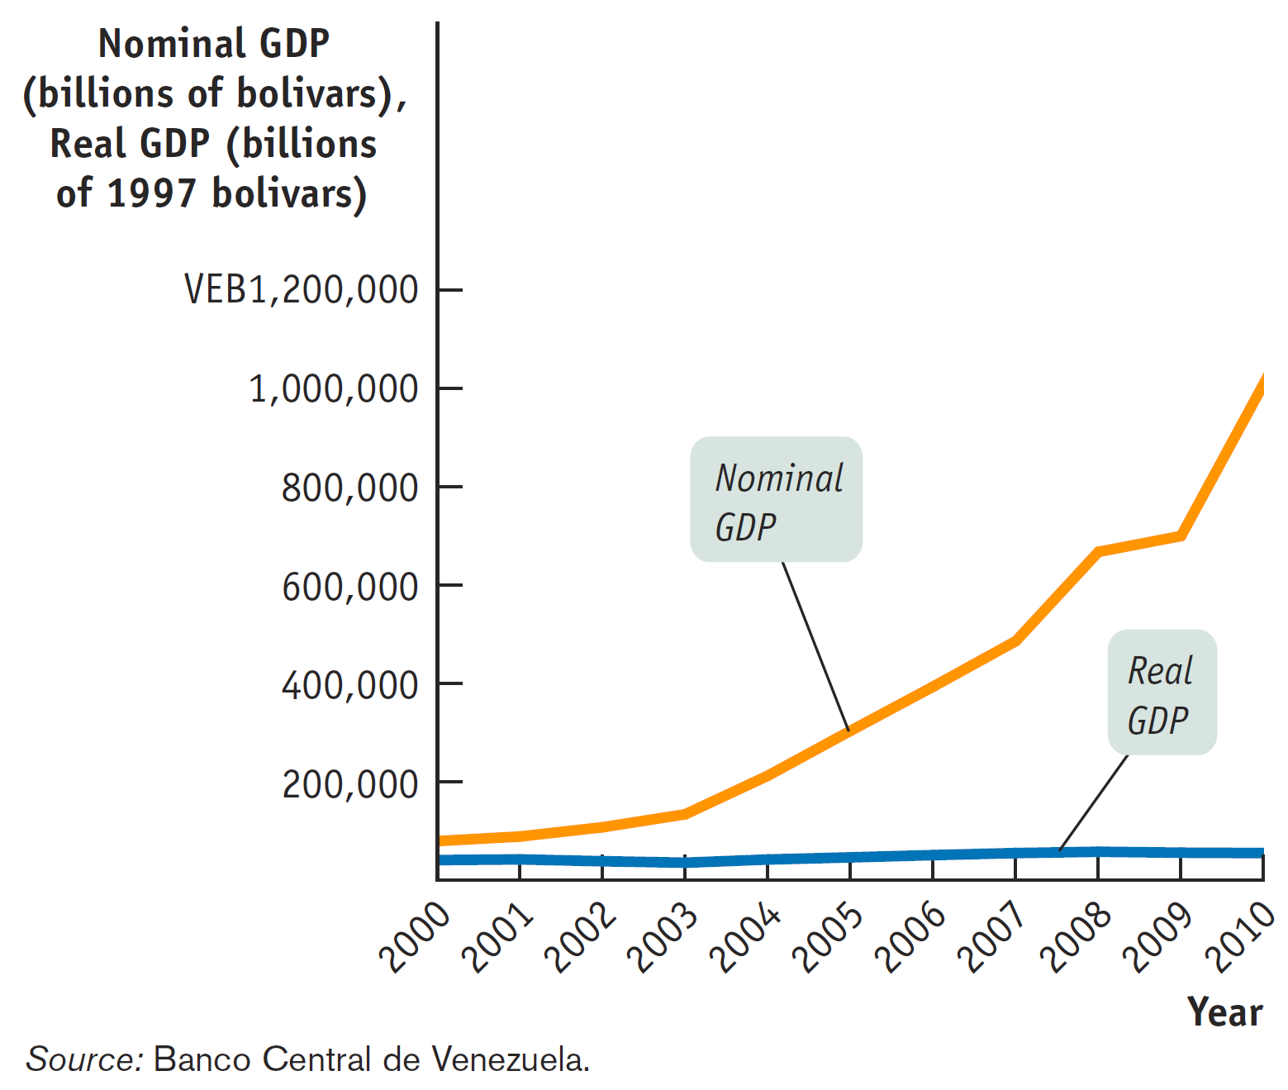
Miracle in Venezuela? Real GDP v. Nominal GDP
No, it’s just suffering from unusually high inflation.

Slide 17
Real GDP
We need to be able track the quantity of total output
over time.
Real GDP: the total value of the final goods and services produced in the economy during a given year, calculated using the prices of a selected base year.
Nominal GDP: the value of all final goods and services produced in the economy during a given year, calculated using the current prices, current in the year in which the output is produced.

Slide 18
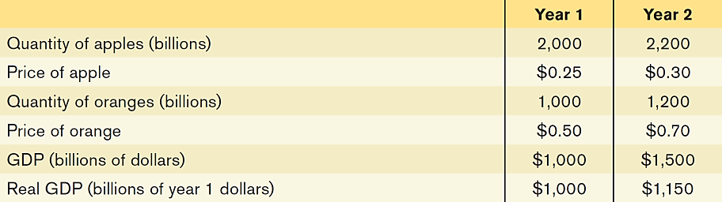
Real vs. Nominal GDP
Calculating GDP and real GDP in a simple economy:
how much would GDP have gone up if prices had not changed?
To answer this question, we need to find the value of output in year 2 expressed in year 1 prices.
The Growth of Nominal GDP: (1500 – 1000) / 1000 = + 50%
The Growth of Real GDP : (1150 – 1000) / 1000 = + 15%
(if Prices had stayed the same, i.e. No Inflation)
It implies there is an Inflation.
Another way of calculating Inflation: using GDP Deflator

Slide 19
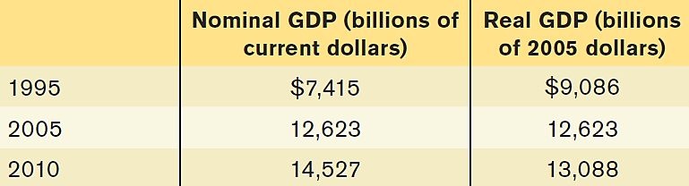
GDP Deflator
GDP Deflator = 100 x (nominal GDP/real GDP)
1995 = 81.61 -- (7415/9086) x 100
2005 = 100.00 -- the base year
2010 = 110.99 -- (14527/13088) x 100
Inflation calculated using GDP Deflator to represent P (Price Level): (P2 – P1) / P1
Inflation between 2005 and 2010: 10.99%
Inflation between 1995 and 2005: 23.45%
If we take Log of this equation: GDP Deflator (P) = 100 x (Nominal GDP/Real GDP)
%growth of P (=Inflation) = %growth of NGDP - %growth of RGDP
Between 2005-2010: Between 1995-2005:
Growth of NGDP: ….. % Growth of NGDP: …%
Growth of RGDP: …..% Growth of RGDP: …%
The inflation rate is: …..% The inflation rate is: …..%

Slide 20
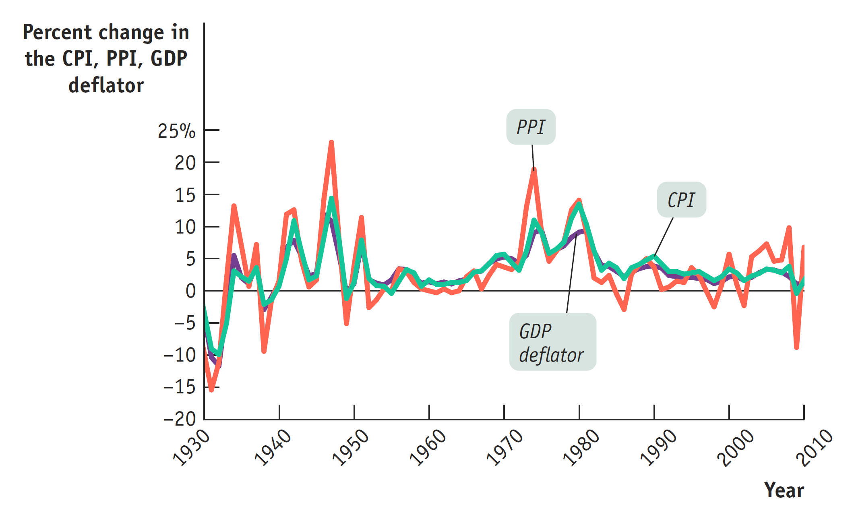
The CPI, the PPI, and the GDP Deflator
The three measures usually move closely together.
Inflation rate is the percent change of either CPI, PPI, or GDP Deflator
Notice that PPI curves are more pronounced, a proof of “Sticky” Prices
Source: Bureau of Labor Statistics.

Slide 21
CPI – Consumer Price Index
A measure of changes in overall prices of consumer goods (retail, not wholesale)
Inflation: an increase in price level
Deflation: a decrease in price level
PPI: Producer Price Index
A measure of changes in wholesale prices
Source: BLS.gov
Note: GDP Deflator is NOT Deflation (fall in price level)

Slide 22
Creating a Simple Price Index
Assumption in CPI: Quantity stays the same, allow Prices to change;
But in Real GDP: Prices are kept the same, allow Quantity to change.
 |  | 2013 = Base year |  | 2014
Good | Quantity | Price | Cost | Price | Cost
Popcorn | 2 | $4 | $8 | $6 | $12
Lemonade | 2 | $4 | $8 | $4 | $8
Movie ticket | 1 | $8 | $8 | $10 | $10
Basket Price |  |  | $24 |  | $30
Inflation rate: (P2 – P1) / P1 = 25%
Notes:
Lecture Notes:
Consider the three goods, each given a price and quantity.
“Cost” in this case is the total amount of money you expended on the item. Your total money spend is shown too.
Main point of the table: Given a “base” year of 2013, we purchased some goods and spent $24. In the next year 2014, we purchased the same goods, but we note that some (but not all) of the prices have changed, and we spend a total of $30 for the same goods.
To create an index, we use our “base” year and give it an index of 100 as a figure to compare other years to. To get the index for the other years, we divide the basket price in the new year divided by the basket price in the base year.
With steady inflation, all indices before our base year should be less than 100, and all indices after our base year should be greater than 100.

Slide 23
Price & Wage Comparison across time and place
CPI 1983 = 100 compared to: $ 1983
CPI today = 237 $ today
1983 Today (estimated)
Median home price: $64,200 (237/100) x $64,200
Median household income: $17,710 ?
---------------------------------------------------------------------------------------------------------------------------------------------------
Cost of Living across states: (Cost of Living Index – Selected Urban Areas)
Atlanta, GA: 95.6
Seattle, WA: 121.4
New York, NY: 216.7
San Francisco: 164
Atlanta Seattle New York San Francisco
Accountant $52,000 x (121.4/95.6)
Sales Professional $56,000 x (121.4/95.6)

Slide 24

Try this:
Inflation-Adjusted Wages:
You have just been awarded a cost-of-living increase tied to the CPI. The CPI has gone from 110 to 112. If your salary is $30,000 per year before the increase, what will it be after the CPI increase is factored in?
$29,464
$30,545
$30,600
$33,600

Slide 25
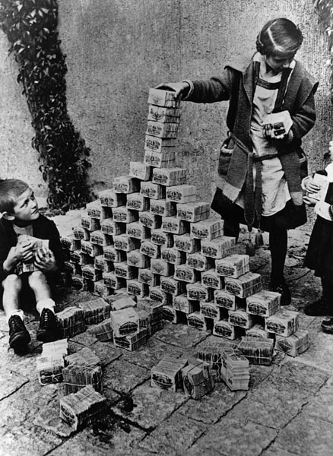
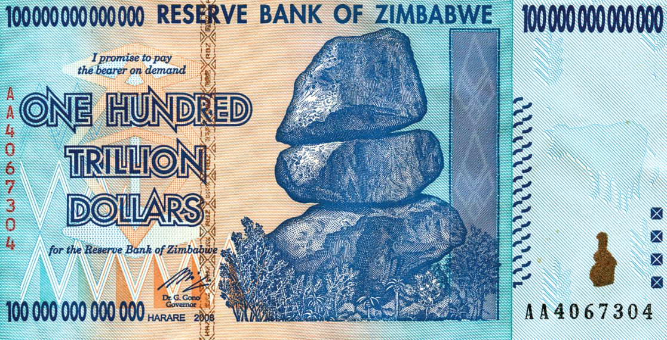
Costs of Inflation
The Costs of Inflation are:
Shoe-Leather Cost
The shoe-leather costs of inflation in Israel: When the inflation rate hit 500% in 1985, people spent a lot of time in line at banks.
2) Menu Cost
the real cost of changing a listed price in restaurants, stores, businesses.
3) Unit-of-Account Cost
costs arising from the way inflation makes money a less reliable unit of measurement.
Calculations are hard when inflation is high.

Slide 26

The Cause of Inflation
Demand-Pull inflation
Inflation caused by increased in Demand for goods.
A mild inflation is a good sign of a healthy economy.
A rush inflation is a bad sign:
-“Irrational Exuberance” demand for housing
-Speculation in the stock markets
Supply-Push inflation
1973 oil shock is an example.
A continuous increase in “money printing” as happened in Zimbabwe, 2008.
Notes:
Lecture Notes:
But inflation is a continued rise in the general price level. This definition helps us focus on long-run price level changes. And when we define inflation this way, it’s clear that the cause is when a nation’s money supply increases too quickly.
When the supply of money in an economy grows relative to the quantity of goods and services, then it takes more money to buy any particular good or service. Money becomes less valuable—and this is inflation.

Slide 27
Winners and Losers from Inflation
If inflation is different from predictions, some will lose and some will benefit.
Interest rate: the price that a lender charges for the use of his or her savings for one year.
Nominal interest rate: the interest rate expressed in dollar terms.
Real interest rate: the nominal interest rate minus the rate of inflation.
eg: if nominal rate is 5%, and inflation is 13%,
the real interest rate is: 5%-13% = -8%
-For a borrower: now paying zilch!
- For a lender (bank): now get nothing!

Slide 28


Winners and Losers from Inflation
Americans who took out mortgages (fixed at 5% rate) in the early 1970s quickly found their real payments reduced by higher-than-expected inflation.
(Due to Oil Crisis in the 70s, Inflation rate suddenly shoot up to double digit; and Home Loans in the 7os are “Fixed” rather “Adjustable” rate that we know now.) Many banks collapsed due to the negative real interest rates, and they now introduced the Adjustable Mortgage rate.

